Slide 1
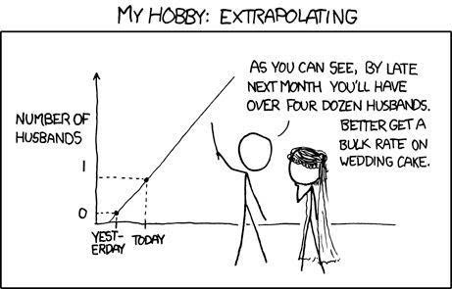
Assessing normality; Wilcoxon Tests
Geog4300/6300
Jerry Shannon

Slide 2
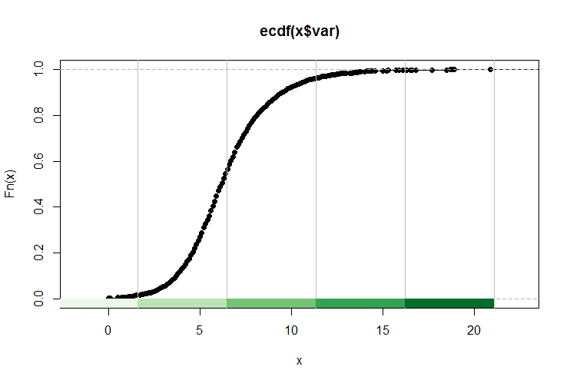
QQ plot: comparing % against actual value

Slide 3
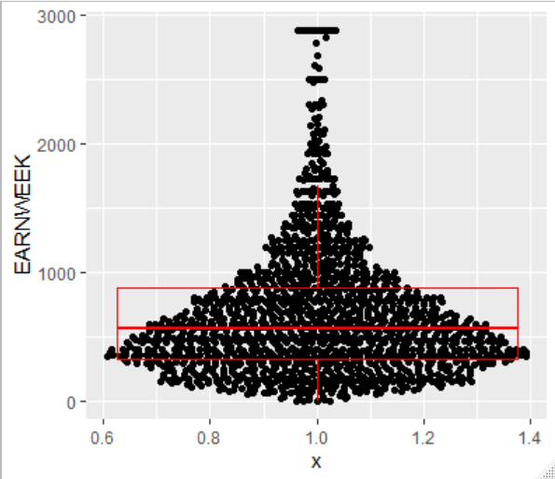
The EARNWEEK variable distribution
90th percentile
75th percentile
25th percentile
10th percentile

Slide 4
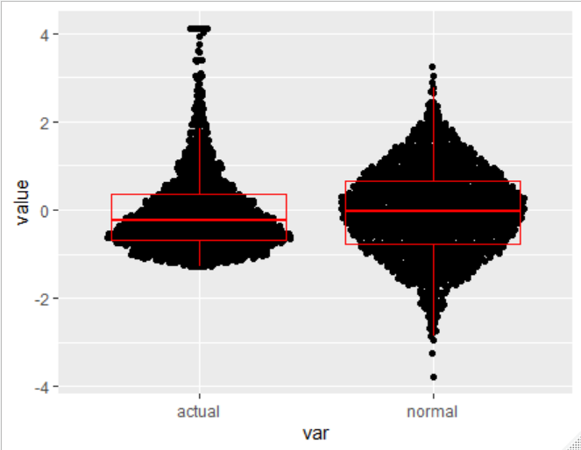
Compare an equivalent normal distribution
90th percentile
75th percentile
25th percentile
10th percentile

Slide 5
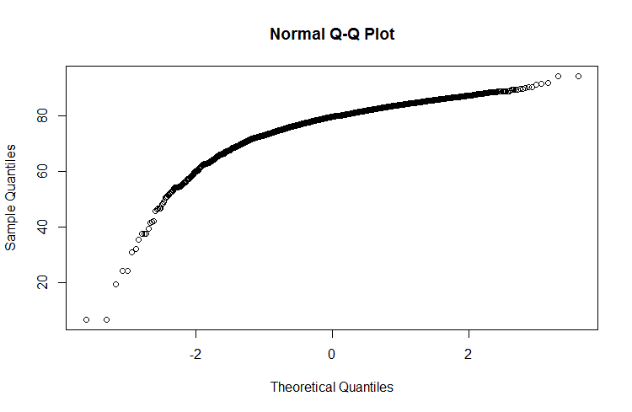
Testing normality with QQ plots
Comparing actual data with a normal distribution
Z score of actual data
Z score of a hypothetical
normal distribution

Slide 6
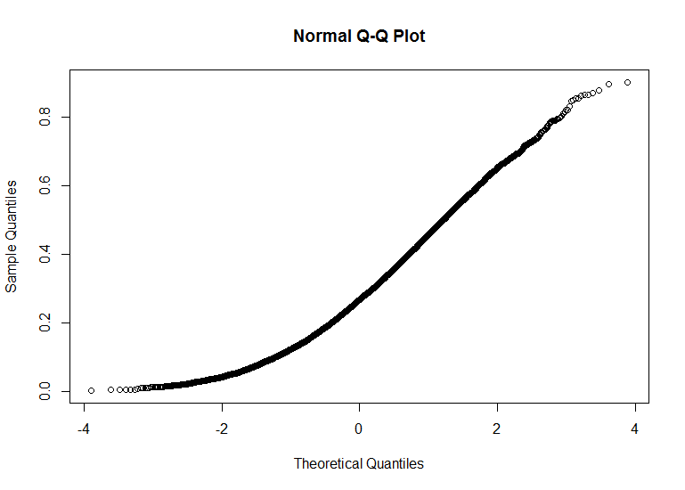
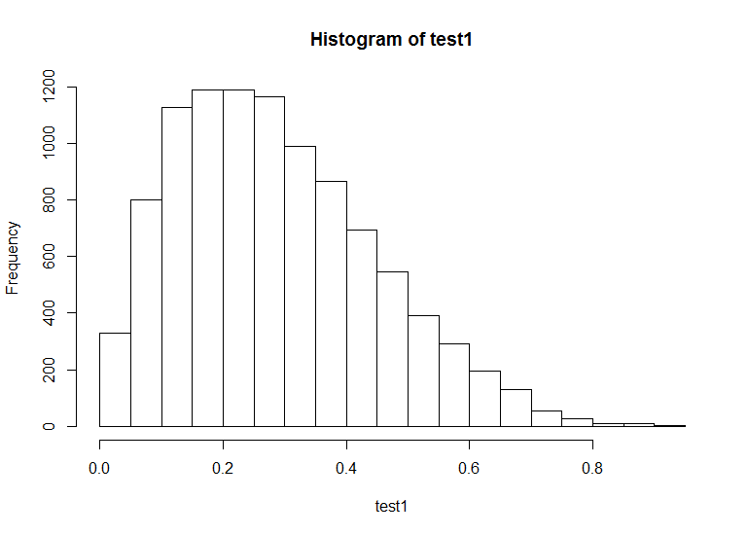

Slide 7
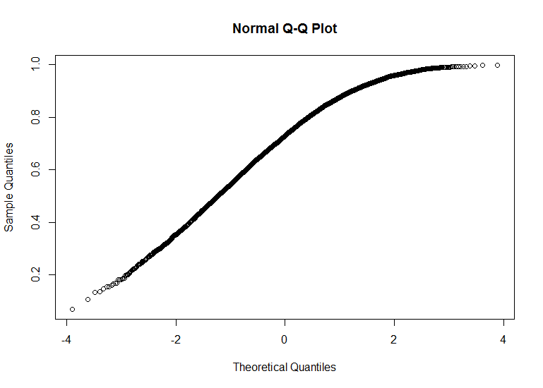
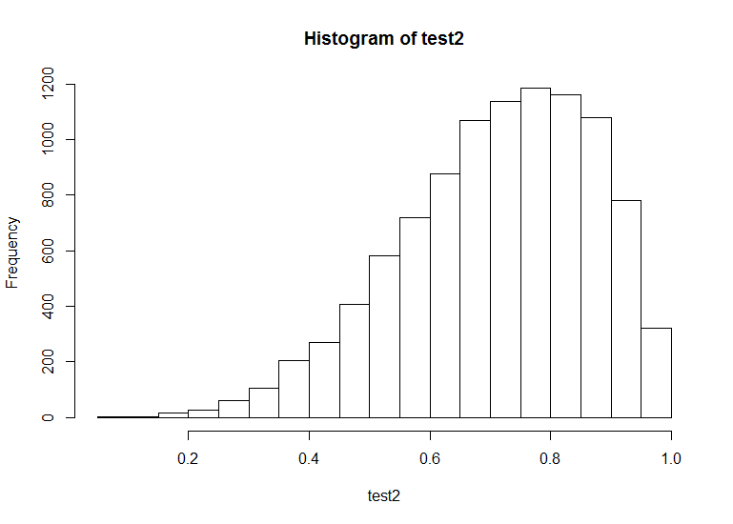

Slide 8
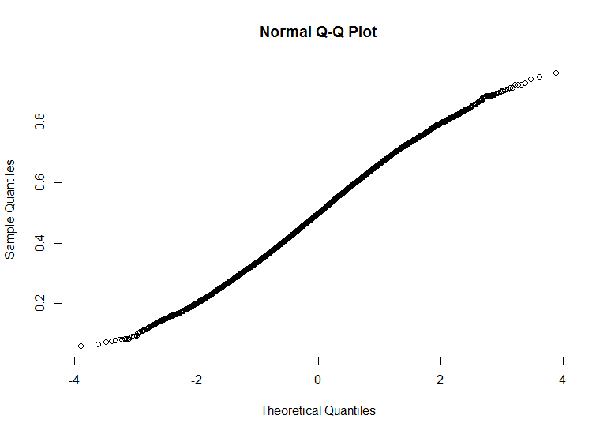
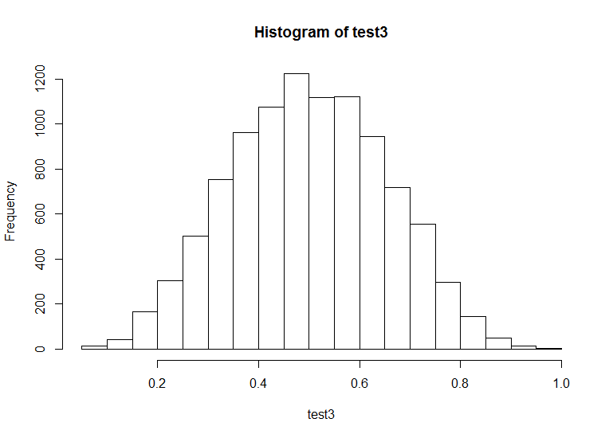

Slide 9
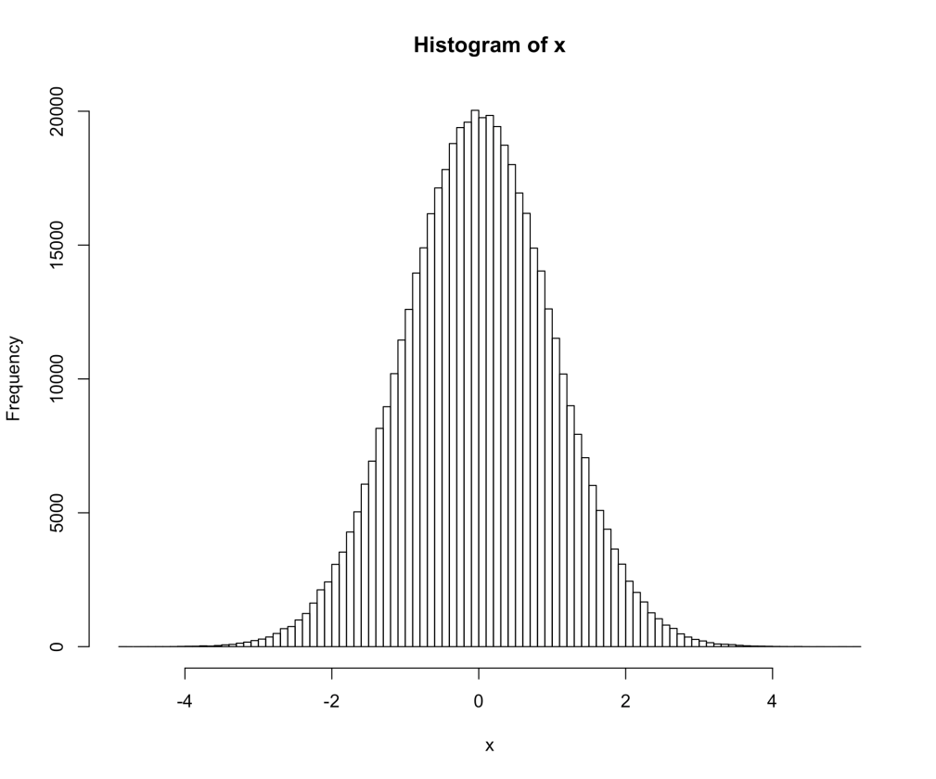
The Shaprio-Welk normality test compares the actual distribution to a normal distribution, measuring the gap between them at multiple points.
There are other normality test, but this one has more power when compared to other tests, especially with smaller (<50) samples.

Slide 10
What if your samples aren’t normal?
Number of named Atlantic tropical storms, years
Random sample of hurricanes in El Nino and La Nina years—11 each
You need a non-parametric test with data that’s not normal.
El Nino | La Nina
0 | 4
5 | 4
1 | 12
3 | 2
4 | 17
1 | 7
2 | 6
2 | 10
0 | 4
2 | 8
4 | 6

Slide 11

What if your samples aren’t normal?
Wilcoxon tests are one common alternative.
Two tests:
Rank sum: alternative to two sample t-test
Matched-Pairs Signed-ranks: alternative to matched pairs test
Frank Wilcoxon
Speed demon and statistician

Slide 12
Wilcoxon Rank Sum test
Number of named Atlantic tropical storms, years
Question: Is the number of Atlantic storms significantly different in El Nino years compared to La Nina years?
El Nino | La Nina
0 | 4
5 | 4
1 | 12
3 | 2
4 | 17
1 | 7
2 | 6
2 | 10
0 | 4
2 | 8
4 | 6

Slide 13
Wilcoxon Rank Sum test
Number of named Atlantic tropical storms, years
Convert your data to ordinal ranks.
When tied, average the rank.
El Nino | La Nina
0 (1.5) | 4 (12)
5 (15) | 4 (12)
1 (3.5) | 12 (21)
3 (9) | 2 (6.5)
4 (12) | 17 (22)
1 (3.5) | 7 (18)
2 (6.5) | 6 (16.5)
2 (6.5) | 10 (20)
0 (1.5) | 4 (12)
2 (6.5) | 8 (19)
4 (12) | 6 (16.5)

Slide 14
Wilcoxon Rank Sum test
Number of named Atlantic tropical storms, years
El Nino | La Nina
0 (1.5) | 4 (12)
5 (15) | 4 (12)
1 (3.5) | 12 (21)
3 (9) | 2 (6.5)
4 (12) | 17 (22)
1 (3.5) | 7 (18)
2 (6.5) | 6 (16.5)
2 (6.5) | 10 (20)
0 (1.5) | 4 (12)
2 (6.5) | 8 (19)
4 (12) | 6 (16.5)
Then sum the ranks in each column.
If the two columns are equal, the ranks should also be equal.
W₁ = 77.5 W₂ = 175.5

Slide 15
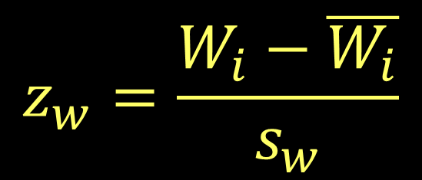
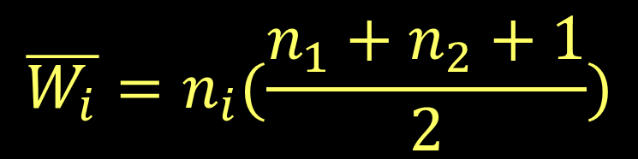
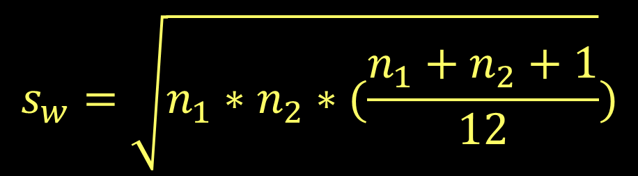
Wilcoxon Rank Sum test
Compare the observed rank sum to that we’d expect if the two groups were equal
W statistic for sample i
This statistic is a normal distribution

Slide 16
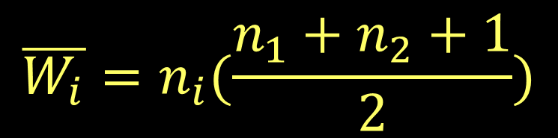
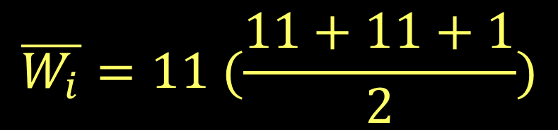

Wilcoxon Rank Sum test
Number of named Atlantic tropical storms, years
El Nino | La Nina
0 (1.5) | 4 (12)
5 (15) | 4 (12)
1 (3.5) | 12 (21)
3 (9) | 2 (6.5)
4 (12) | 17 (22)
1 (3.5) | 7 (18)
2 (6.5) | 6 (16.5)
2 (6.5) | 10 (20)
0 (1.5) | 4 (12)
2 (6.5) | 8 (19)
4 (12) | 6 (16.5)
W₁ = 77.5 W₂ = 175.5

Slide 17
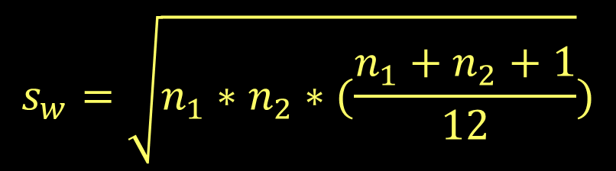
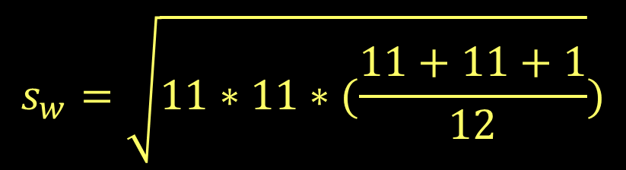

Wilcoxon Rank Sum test
Number of named Atlantic tropical storms, years
El Nino | La Nina
0 (1.5) | 4 (12)
5 (15) | 4 (12)
1 (3.5) | 12 (21)
3 (9) | 2 (6.5)
4 (12) | 17 (22)
1 (3.5) | 7 (18)
2 (6.5) | 6 (16.5)
2 (6.5) | 10 (20)
0 (1.5) | 4 (12)
2 (6.5) | 8 (19)
4 (12) | 6 (16.5)
W₁ = 77.5 W₂ = 175.5

Slide 18
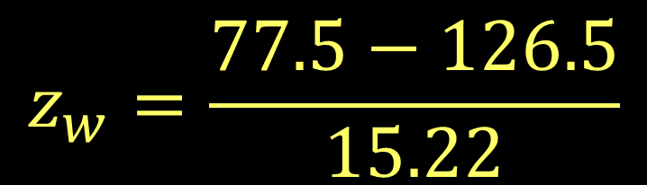

Wilcoxon Rank Sum test
Number of named Atlantic tropical storms, years
El Nino | La Nina
0 (1.5) | 4 (12)
5 (15) | 4 (12)
1 (3.5) | 12 (21)
3 (9) | 2 (6.5)
4 (12) | 17 (22)
1 (3.5) | 7 (18)
2 (6.5) | 6 (16.5)
2 (6.5) | 10 (20)
0 (1.5) | 4 (12)
2 (6.5) | 8 (19)
4 (12) | 6 (16.5)
Shows a significant difference between years
W₁ = 77.5 W₂ = 175.5

Slide 19
Wilcoxon Matched Pairs Signed-Ranks test
Non-parametric version of a matched pairs test
Goal is to compare changes in rank between matched samples
 | 2000 | 2010
A | 3 | 6
B | 11 | 12
C | 9 | 8
D | 14 | 18
E | 17 | 15
F | 7 | 13
G | 21 | 25
H | 13 | 9
I | 19 | 24
J | 5 | 10
Question: Did the rank of this region’s cities change significantly?
Regional cities’ national rank for population growth in previous 10 years

Slide 20
Wilcoxon Matched Pairs Signed-Ranks test
First find the absolute difference in ranks
Then assign ranks—averaging any ties.
 | 2000 | 2010 | Diff
A | 3 | 6 | 3 (4)
B | 11 | 12 | 1 (1.5)
C | 9 | 8 | 1 (1.5)
D | 14 | 18 | 4 (6)
E | 17 | 15 | 2 (3)
F | 7 | 13 | 6 (10)
G | 21 | 25 | 4 (6)
H | 13 | 9 | 4 (6)
I | 19 | 24 | 5 (8.5)
J | 5 | 10 | 5 (8.5)

Slide 21
Wilcoxon Matched Pairs Signed-Ranks test
Sum all positive ranks
(where 2000 > 2010)
And sum all negative ranks
 | 2000 | 2010 | Diff
A | 3 | 6 | 3 (4)
B | 11 | 12 | 1 (1.5)
C | 9 | 8 | 1 (1.5)
D | 14 | 18 | 4 (6)
E | 17 | 15 | 2 (3)
F | 7 | 13 | 6 (10)
G | 21 | 25 | 4 (6)
H | 13 | 9 | 4 (6)
I | 19 | 24 | 5 (8.5)
J | 5 | 10 | 5 (8.5)
T_{p} is the sum of positive ranks (C, E, H): 10.5
T_{n} is the sum of negative ranks (A, B, D, F, G, I, J): 44.5

Slide 22
Wilcoxon Matched Pairs Signed-Ranks test
For two tailed tests, use the smaller T (T_{p} here)
For one tailed tests, use the T that has less “members” (also T_{p} in this case—only 3 cities)
 | 2000 | 2010 | Diff
A | 3 | 6 | 3 (4)
B | 11 | 12 | 1 (1.5)
C | 9 | 8 | 1 (1.5)
D | 14 | 18 | 4 (6)
E | 17 | 15 | 2 (3)
F | 7 | 13 | 6 (10)
G | 21 | 25 | 4 (6)
H | 13 | 9 | 4 (6)
I | 19 | 24 | 5 (8.5)
J | 5 | 10 | 5 (8.5)
T_{p} is the sum of positive ranks (C, E, H): 10.5
T_{n} is the sum of negative ranks (A, B, D, F, G, I, J): 44.5

Slide 23
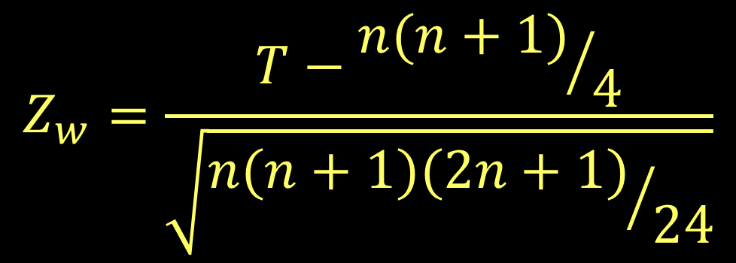
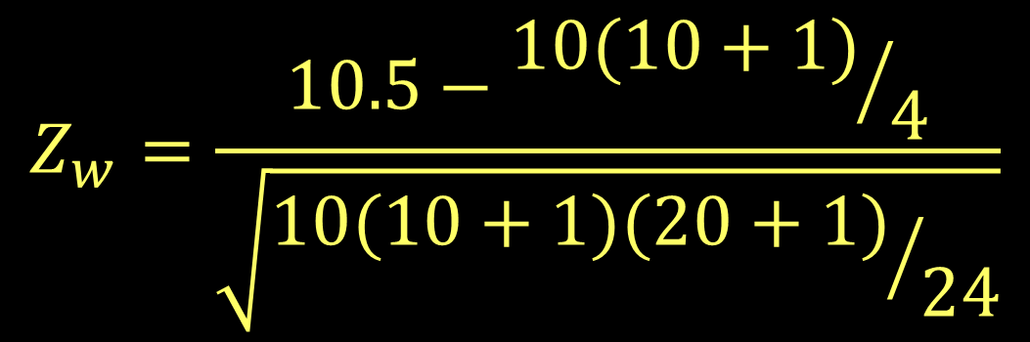


Wilcoxon Matched Pairs Signed-Ranks test

Slide 24
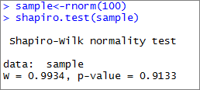

Wilcoxon and normality tests in R

